Slide 1
Sentiment Analysis Model
By: Cindy Suyitno

Slide 2

Layout
Introduction
Database Information
Data Cleaning
Data Preprocessing
Data Modelling
Deployment
Conclusion and Suggestion

Slide 3

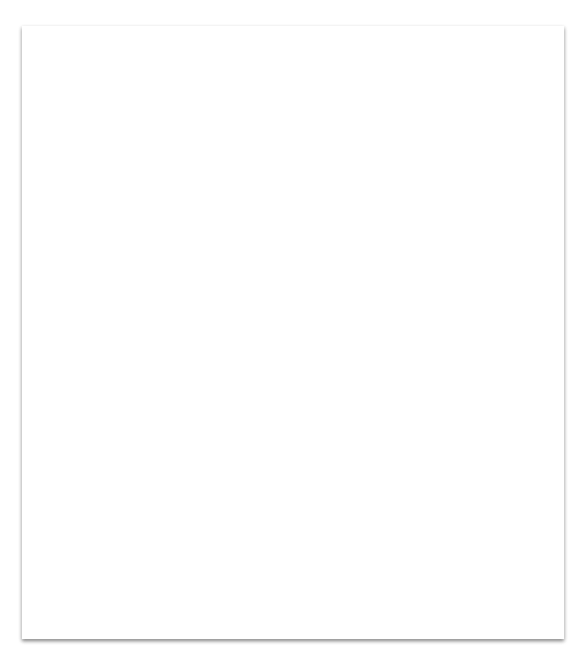
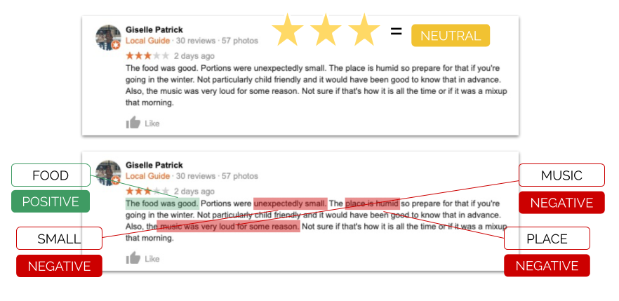
1. Introduction
Why sentiment analysis?
Definition Sentiment analysis is an automatic process that uses artificial intelligence to assign a value from +1 (extremely positive) to -1 (extremely negative) to bits of text.
Function Through sentiment analysis, business owners can capture the emotion behind a star rating and begin to understand what attributes contributed to or detracted from a positive experience at the business. For example, a review can still be rated five stars and mention that the burgers were burnt.
Image source: https://www.vendasta.com/blog/sentiment-analysis-turns-reviews-into-insights/

Slide 4
In this project we will use amazon product reviews to get sentiment analysis model.
Customers
leave tons of advice, reviews, complaints, and appreciation in a business portal. Do we need to read them one by one?

Slide 5
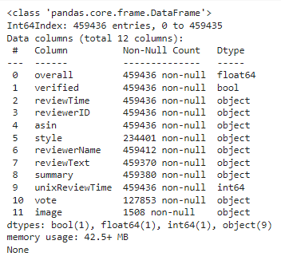
2. Database Info
The columns that are used:
reviewTime: time when the reviews are added
reviewText: customer reviews text
overall: overall ratings by customers
Data source: http://deepyeti.ucsd.edu/jianmo/amazon/index.html

Slide 6
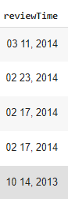
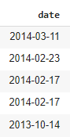
3. Data Cleaning
Change data type
Drop null values
Drop duplicated values

Slide 7
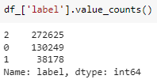
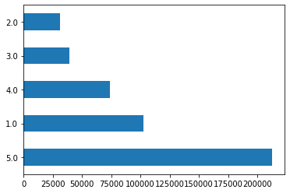
4. Data Preprocessing Timeline
Splitting Data
Checking Imbalance
Labelling Data
Feature Extraction
Split the data into X,y
Undersampling X,y
Split into half since the data is so big
Split into train-test data (ratio: 80-20)
The data is imbalance (higher 5 ratings)
df[‘rating’].value_counts().plot(kind=’barh’)
def get_rating_cat(rating)
undersampling.RandomSampler(), train_test_split()
TF-IDF (Term Frequency-Inverse Document Frequency)
The ratings will be divided into 3 sentiment category:
Negative (label 0): rating 1-2
Neutral(label 1): rating 3
Positive(label 2): rating 4-5
Vectorize the review text into a usable vector

Slide 8
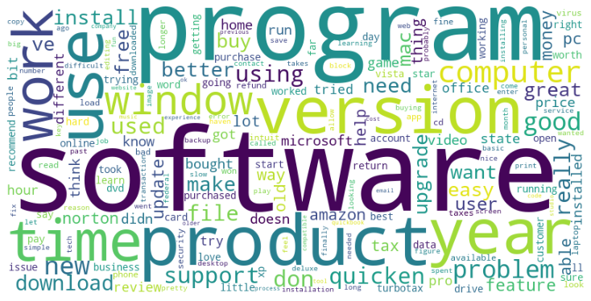
Data Visualization
Using wordclouds for text analysis (the bigger the text, the more times it appears in the reviews) we can see that lots of reviews are in neutral terms.

Slide 9
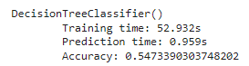
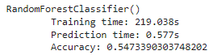
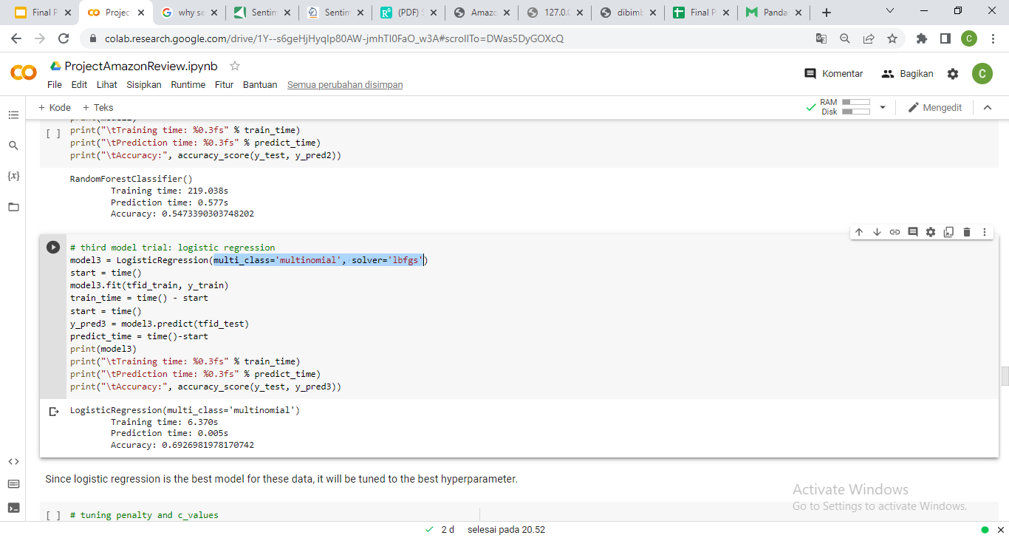
4. Modelling
Decision Tree Classifier
Random Forest Classifier
Logistic Regression
(multiclass=’multinomial’, solver=’lbfgs’)

Slide 10
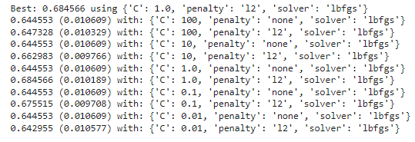
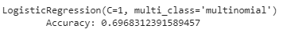
Hypertuning parameter:
solvers = ['lbfgs','sag', 'saga','newton-cg']
penalty = ['none','l2']
c_values = [100, 10, 1.0, 0.1, 0.01]
Train all dataset:
model_final = LogisticRegression(multi_class='multinomial', solver='lbfgs', penalty='l2', C=1)
model_final.fit(tfid_train, y_train)
y_pred_final = model_final.predict(tfid_test)
Before:
After:

Slide 11
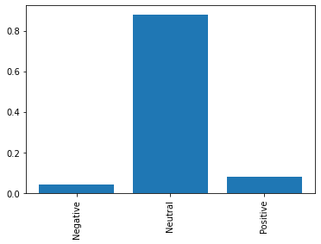
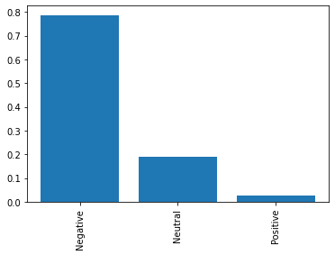
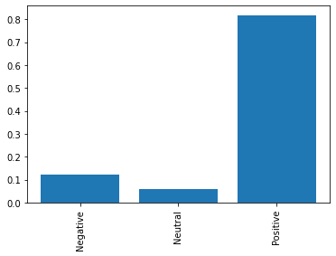
Testing Model
test_text = ['It is alright','I hate it','Oh it was a wonderful experience!']

Slide 12
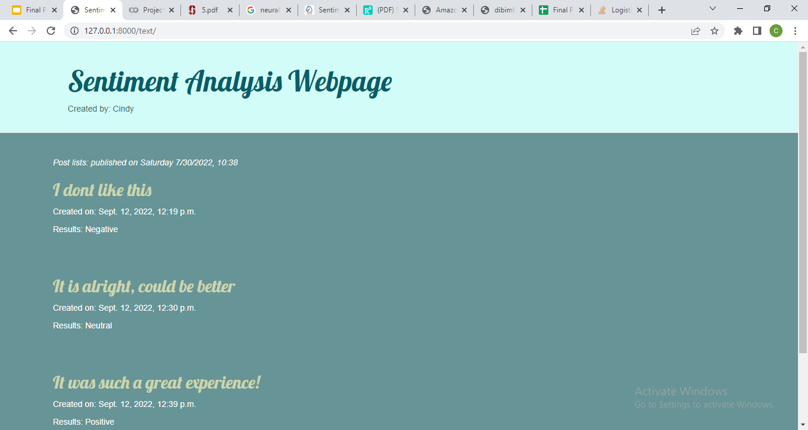
5. Deployment
Link Here (only local computer)

Slide 13
5. Conclusion and Suggestion
The best sentiment analysis model for this database is Logistic Regression
It is better to combine the database with other company’s customer reviews, so that we can get more general train data.
If there is more time and RAM, other models can also be explored (like NaiveBayes, neural networks, etc).

Slide 14

Thank you!
Google colab link

